Slide 1
Task 2

Slide 2
Vulnerabilities detected by Netsparker(Critical):
Out-of-date version (Apache)
Out-of-date version (OpenSSL)
Out-of-date version (Tomcat)

Slide 3
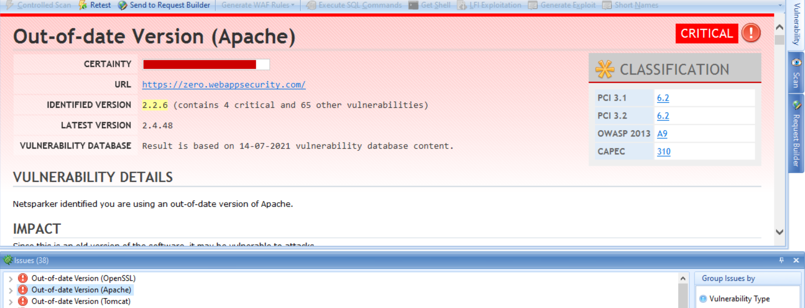
Screenshots:
1. Netsparker detected critical vulnerabilities:

Slide 4
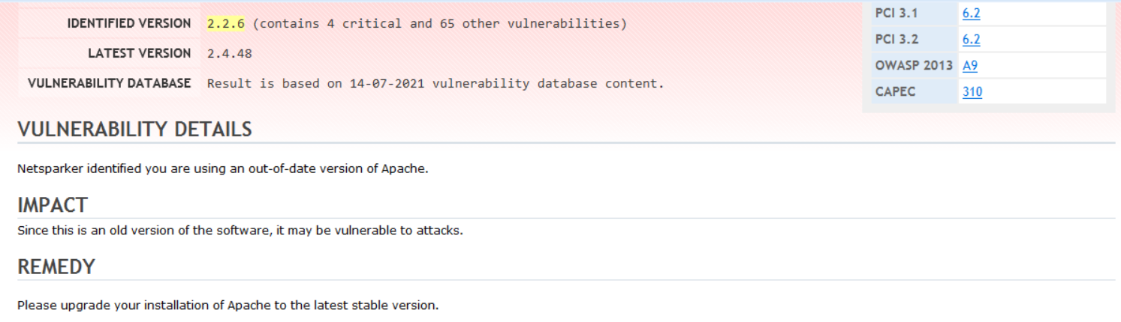
2. Report generated by Netsparker:

Slide 5
Written report:
Vulnerability detected: Out-of-date version(Apache)
URL: http//zero.webappsecurity.com/
Impact:
Using older versions of software will make it more vulnerable to attacks as it won't be able to withstand an up-to-date cyber attack.
Remedy:
Timely upgradation of the software to the latest version.

